Slide 1
Lesson01- Kubernetes Architecture

Slide 2
Lesson Objectives
Kubernetes Masters
Kubernetes Nodes
Architecture & Module Overview
The Declarative Model and Desired State
Kubernetes Big Picture View
Kubernetes Pods
Notes:
Add instructor notes here.

Slide 3
Lesson Objectives
Stable Networking with Kubernetes Services
The Kubernetes API and API Server
Scheduler
Game Changing Deployments
Controller Manager
etcd - the cluster brain
Notes:
Add instructor notes here.

Slide 4
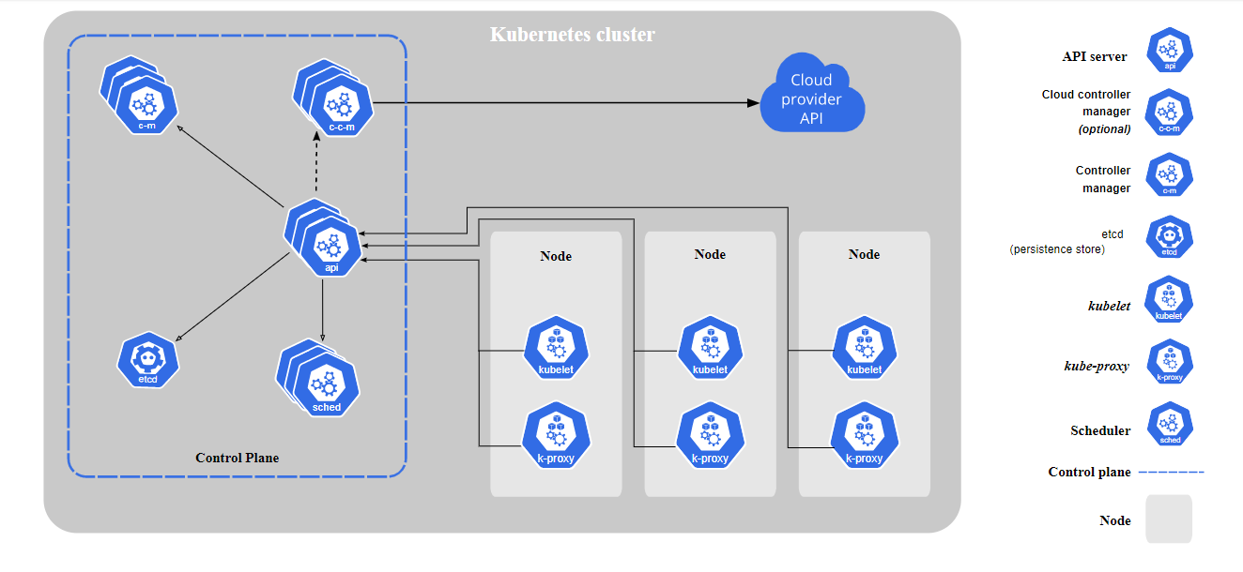
Kubernetes Architecture-Kubernetes Big Picture View
Notes:
-When you deploy Kubernetes, you get a cluster.
-A Kubernetes cluster consists of a set of worker machines, called nodes, that run containerized applications.
-Every cluster has at least one worker node.
-The worker node(s) host the Pods that are the components of the application workload.
-The control plane manages the worker nodes and the Pods in the cluster.
-In production environments, the control plane usually runs across multiple computers and a cluster usually runs multiple nodes, providing fault-tolerance and high availability.

Slide 5
Kubernetes Architecture-Kubernetes Big Picture View-Control Plane Components
kube-apiserver
etcd
kube-scheduler
kube-controller-manager
cloud-controller-manager
Notes:
-[Master]-Control Plane Components - The control plane's components make global decisions about the cluster (for example, scheduling),
as well as detecting and responding to cluster events (for example, starting up a new pod when a deployment's replicas field is unsatisfied).
Control plane components can be run on any machine in the cluster. However, for simplicity, set up scripts typically start all control plane components on the same machine, and do not run user containers on this machine.
-kube-apiserver-The API server is a component of the Kubernetes control plane that exposes the Kubernetes API. The API server is the front end for the Kubernetes control plane.The main implementation of a Kubernetes API server is kube-apiserver. kube-apiserver is designed to scale horizontally—that is, it scales by deploying more instances. You can run several instances of kube-apiserver and balance traffic between those instances.
-etcd-Consistent and highly-available key value store used as Kubernetes' backing store for all cluster data.
If your Kubernetes cluster uses etcd as its backing store, make sure you have a back up plan for those data.
-kube-scheduler
Control plane component that watches for newly created Pods with no assigned node, and selects a node for them to run on.
Factors taken into account for scheduling decisions include: individual and collective resource requirements, hardware/software/policy constraints, affinity and anti-affinity specifications, data locality, inter-workload interference, and deadlines.
-kube-controller-manager- Control Plane component that runs controller processes.
Logically, each controller is a separate process, but to reduce complexity, they are all compiled into a single binary and run in a single process.
These controllers include:
Node controller: Responsible for noticing and responding when nodes go down.
Replication controller: Responsible for maintaining the correct number of pods for every replication controller object in the system.
Endpoints controller: Populates the Endpoints object (that is, joins Services & Pods).
Service Account & Token controllers: Create default accounts and API access tokens for new namespaces.
-cloud-controller-manager-A Kubernetes control plane component that embeds cloud-specific control logic.
The cloud controller manager lets you link your cluster into
your cloud provider's API, and separates out the components that interact with that cloud platform from components that
just interact with your cluster. The cloud-controller-manager only runs controllers that are specific to your cloud provider.
If you are running Kubernetes on your own premises, or in a learning environment inside your own PC, the cluster does not have a cloud controller manager.
As with the kube-controller-manager, the cloud-controller-manager combines several logically independent control loops into a single binary that you run as a single process. You can scale horizontally (run more than one copy) to improve performance or to help tolerate failures.
The following controllers can have cloud provider dependencies:
Node controller: For checking the cloud provider to determine if a node has been deleted in the cloud after it stops responding
Route controller: For setting up routes in the underlying cloud infrastructure
Service controller: For creating, updating and deleting cloud provider load balancers

Slide 6
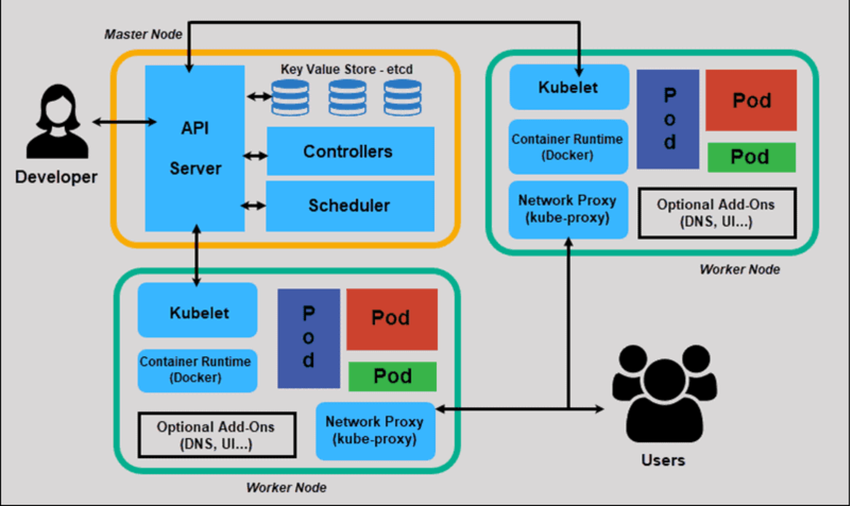
Kubernetes Architecture-Kubernetes Big Picture View
Notes:
Kubernetes has a decentralized architecture that does not handle tasks sequentially
It functions based on a declarative model and implements the concept of a ‘desired state.’ These steps illustrate the basic Kubernetes process:
An administrator creates and places the desired state of an application into a manifest file.
The file is provided to the Kubernetes API Server using a CLI or UI.
Kubernetes’ default command-line tool is called kubectl
Kubernetes stores the file (an application’s desired state) in a database called the Key-Value Store (etcd).
Kubernetes then implements the desired state on all the relevant applications within the cluster.
Kubernetes continuously monitors the elements of the cluster to make sure the current state of the application does not vary from the desired state.

Slide 7
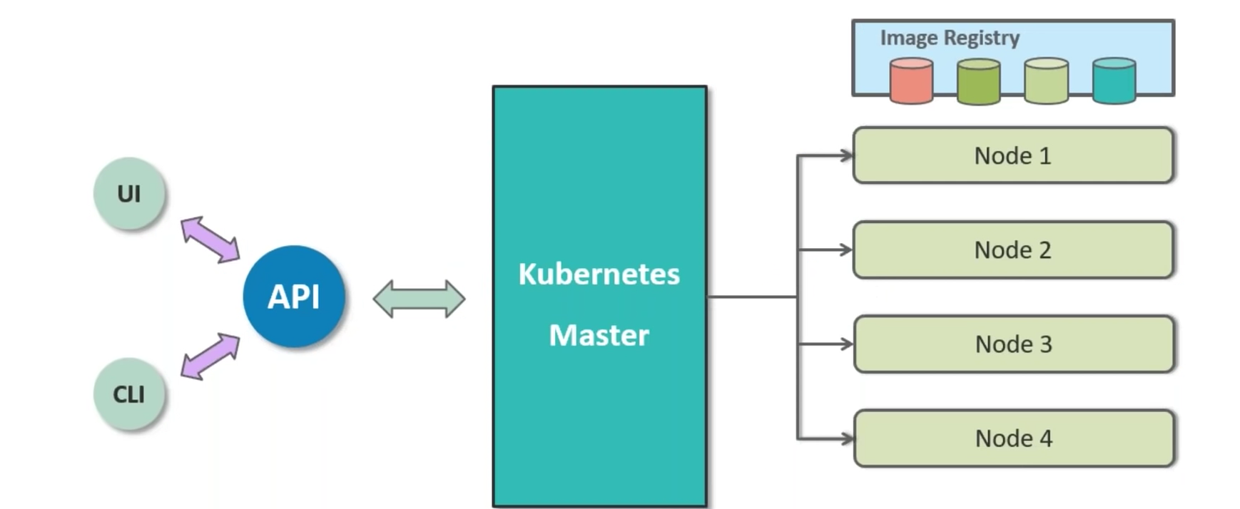
Kubernetes Architecture-Kubernetes Masters
Notes:
Kubernetes master is also called as Control Plane.
Kubernetes Maser is a collection of system services that makes up the control plane of master.
Kubernetes master control everything.
Kubernetes cluster is made up of masters and nodes
First create a kubernetes master which is first step to create the clusters.
All container will be running in the node but not in the Kube masters.
Get the node to join the clusters.
Pods and container will be running on Nodes.
Master will be only scheduling and replicating the containers across nodes and make sure that configuration is satisfied which is made in the beginning.
There are 2 ways to access Kubernetes Master
- Using CLI – Default Way where we can enable the dashboard.
- Using GUI –

Slide 8
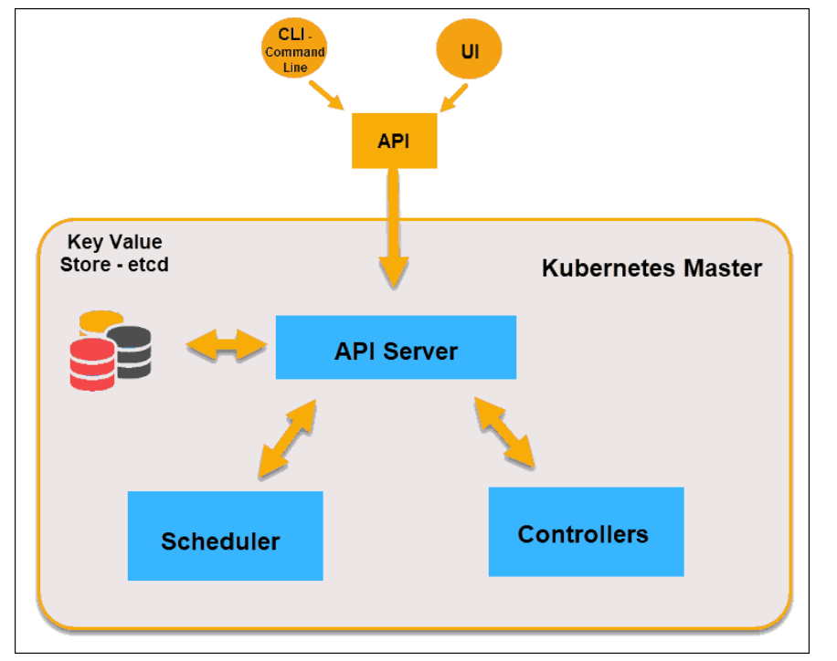
Kubernetes Architecture-Kubernetes Masters
Notes:
The Kubernetes Master (Master Node) receives input from a CLI (Command-Line Interface) or UI (User Interface) via an API. These are the commands you provide to Kubernetes.
You define pods, replica sets, and services that you want Kubernetes to maintain. For example, which container image to use, which ports to expose, and how many pod replicas to run.
You also provide the parameters of the desired state for the application(s) running in that cluster.
Following are key components of Kubernetes master
-API Server
The API Server is the front-end of the control plane and the only component in the control plane that we interact
with directly. Internal system components, as well as external user components, all communicate via the same API.
-Key-Value Store (etcd)
The Key-Value Store, also called etcd, is a database Kubernetes uses to back-up all cluster data. It stores the entire configuration and state of the cluster. The Master node queries etcd to retrieve parameters for the state of the nodes, pods, and containers.
-Controller
The role of the Controller is to obtain the desired state from the API Server. It checks the current state of the nodes it is tasked to control, and determines if there are any differences, and resolves them, if any.
-Scheduler
A Scheduler watches for new requests coming from the API Server and assigns them to healthy nodes. It ranks the quality of the nodes and deploys pods to the best-suited node. If there are no suitable nodes, the pods are put in a pending state until such a node appears.

Slide 9
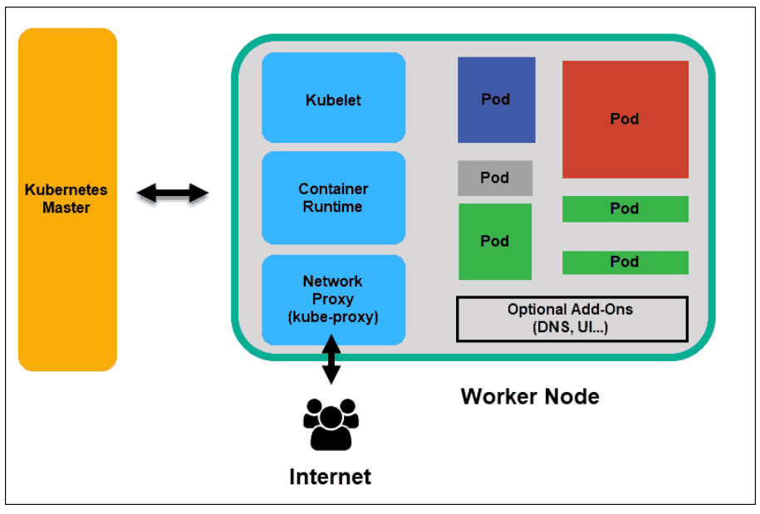
Kubernetes Architecture-Kubernetes Nodes
Notes:
Node are workers/slave of kubernetes cluster.
Worker nodes listen to the API Server for new work assignments; t
They execute the work assignments and then report the results back to the Kubernetes Master node.
Following are the major components of Kubernetes.
-Kubelet
The kubelet runs on every node in the cluster. It is the principal Kubernetes agent. By installing kubelet, the node’s CPU, RAM, and storage become part of the broader cluster. It watches for tasks sent from the API Server, executes the task, and reports back to the Master. It also monitors pods and reports back to the control panel if a pod is not fully functional. Based on that information, the Master can then decide how to allocate tasks and resources to reach the desired state.
- Container Runtime
The container runtime pulls images from a container image registry and starts and stops containers. A 3rd party software or plugin, such as Docker, usually performs this function.
- Kube-proxy
The kube-proxy makes sure that each node gets its IP address, implements local iptables and rules to handle routing and traffic load-balancing.
- Pod
A pod is the smallest element of scheduling in Kubernetes. Without it, a container cannot be part of a cluster. If you need to scale your app, you can only do so by adding or removing pods.
The pod serves as a ‘wrapper’ for a single container with the application code. Based on the availability of resources, the Master schedules the pod on a specific node and coordinates with the container runtime to launch the container

Slide 10
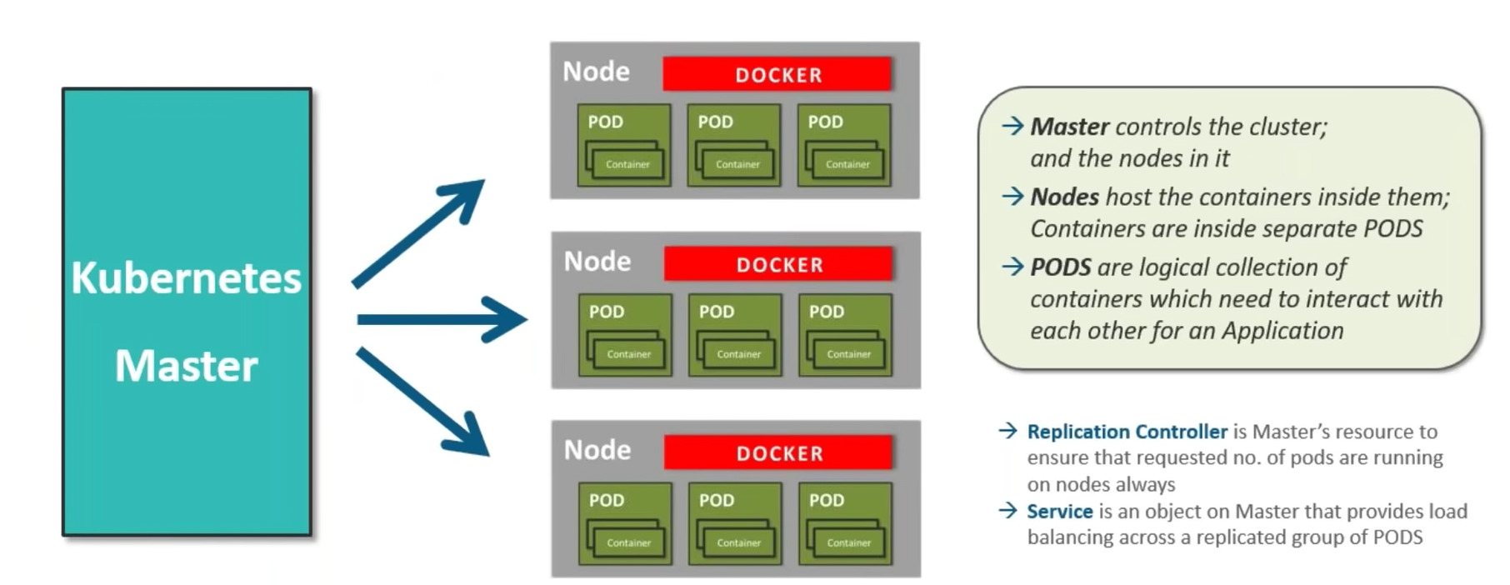
Kubernetes Architecture-Kubernetes Nodes
Notes:
1) kubelet
An agent that runs on each node in the cluster. It makes sure that containers are running in a Pod.
The kubelet takes a set of PodSpecs that are provided through various mechanisms and ensures that the containers described in those PodSpecs are running and healthy. The kubelet doesn't manage containers which were not created by Kubernetes.
2)kube-proxy
kube-proxy is a network proxy that runs on each node in your cluster, implementing part of the Kubernetes Service concept.
kube-proxy maintains network rules on nodes. These network rules allow network communication to your Pods from network sessions inside or outside of your cluster.
kube-proxy uses the operating system packet filtering layer if there is one and it's available. Otherwise, kube-proxy forwards the traffic itself.
3)Container runtime
The container runtime is the software that is responsible for running containers.
Kubernetes supports several container runtimes: Docker, containerd, CRI-O, and any implementation of the Kubernetes CRI (Container Runtime Interface).

Slide 11
Kubernetes Architecture-The Declarative Model and Desired State
1-Declare desire state of miroservice application in the manifest file
2-Post it to the API Server
3-Kubernetes stores it in the cluster store as the application’s desired state
4-Kubernetes implements the desired state on the cluster
5-Kubernetes implements the watch loop to make sure the current state of application does not vary from the desired state.

Slide 12
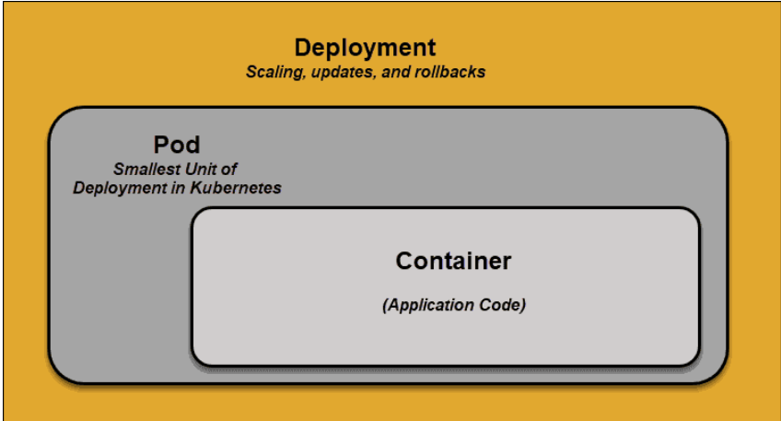
Kubernetes Architecture-Kubernetes PODS
Notes:
POD is a group of containers .
A pod is the smallest element of scheduling in Kubernetes. Without it, a container cannot be part of a cluster.
If you need to scale your app, you can only do so by adding or removing pods.
The pod serves as a ‘wrapper’ for a single container with the application code.
Based on the availability of resources, the Master schedules the pod on a specific node and coordinates with the container runtime to launch the container.
In instances where pods unexpectedly fail to perform their tasks, Kubernetes does not attempt to fix them.
Instead, it creates and starts a new pod in its place. This new pod is a replica, except for the DNS and IP address.
This feature has had a profound impact on how developers design applications.
Due to the flexible nature of Kubernetes architecture, applications no longer need to be tied to a particular instance of a pod.
Instead, applications need to be designed so that an entirely new pod, created anywhere within the cluster, can seamlessly take its place.
To assist with this process, Kubernetes uses services.

Slide 13
Kubernetes Architecture-Stable Networking with Kubernetes Services
Pods are not constant.
One of the best features Kubernetes offers is that non-functioning pods get replaced by new ones automatically.
However, these new pods have a different set of IPs.
It can lead to processing issues, and IP churn as the IPs no longer match.
If left unattended, this property would make pods highly unreliable.
Services are introduced to provide reliable networking by bringing stable IP addresses and DNS names to the unstable world of pods.
Notes:
How Do Kubernetes Services Work?
Pods are associated with services through key-value pairs called labels and selectors.
A service automatically discovers a new pod with labels that match the selector.
This process seamlessly adds new pods to the service, and at the same time, removes terminated pods from the cluster.
For example, if the desired state includes three replicas of a pod and a node running one replica fails, the current state is reduced to two pods. Kubernetes observers that the desired state is three pods.
It then schedules one new replica to take the place of the failed pod and assigns it to another node in the cluster.
The same would apply when updating or scaling the application by adding or removing pods.
Once we update the desired state, Kubernetes notices the discrepancy and adds or removes pods to match the manifest file.
The Kubernetes control panel records, implements, and runs background reconciliation loops that continuously check to see if the environment matches user-defined requirements.

Slide 14
Kubernetes Architecture-Stable Networking with Kubernetes Services
By controlling traffic coming and going to the pod, a Kubernetes service provides a stable networking endpoint – a fixed IP, DNS, and port.
Through a service, any pod can be added or removed without the fear that basic network information would change in any way.

Slide 15
Kubernetes Architecture-The Kubernetes API and API Server
It is grand central station of Kubernetes.
All communication between all components should go through the API Server.
Internal as well as external system components communicate through Same API.
It exposes the Restful API that post YAML configuration files to over HTTPS.
This YAML files are also called as Manifest file which contains the desire state of the application.
The desire state includes things like which container image to use, Which ports to expose and how many PODS replicas to run.
Notes:
-The API Server is the front-end of the control plane and the only component in the control plane that we interact with directly. Internal system components, as well as external user components, all communicate via the same API.
-

Slide 16
Kubernetes Architecture-Scheduler
A Scheduler watches for new requests coming from the API Server and assigns them to healthy nodes.
It ranks the quality of the nodes and deploys pods to the best-suited node.
If there are no suitable nodes, the pods are put in a pending state until such a node appears.
Notes:
Scheduler

Slide 17
Kubernetes Architecture-Controller Manager
The role of the Controller is to obtain the desired state from the API Server..
It checks the current state of the nodes it is tasked to control, and determines if there are any differences, and resolves them, if any.
Notes:
The Logic implemented by Controller is as follows
-Obtain Desire State
-Observe Current State
-Determine difference
-Reconcile Differences

Slide 18
Kubernetes Architecture-etcd
Key-Value Store (etcd)
- The Key-Value Store, also called etcd.
- It is a database Kubernetes uses to back-up all cluster data.
- It stores the entire configuration and state of the cluster.
- The Master node queries etcd to retrieve parameters for the state of the nodes, pods, and containers.

Slide 19
Summary
In this lesson, you have learned about:
Kubernetes Architecture
Notes:
Add instructor notes here.

